Slide 1
Revision Record
Don’t Print This Page
COURSE CODE
PRODUCT
PRODUCT VERSION
COURSE VERSION
Domain
Huawei IPCC and Platform Introduction
NA
eSpace CC ISV V100R001C01LINH04
DEVELOPER / MODIFIER
DATE
APPROVER
NEW / UPDATE
VIJAYASARATHY P. R.
2011-10-12
NEW
SANJAY GUPTA
2011-12-15
UPDATE

Slide 2
Basics of Telephony

Slide 3

Objectives
This course would make the participants aware of the following topics from a contact centre perspective:
Telephone Networks
Various Technologies involved in Telephony

Slide 4

Target Audience
This course has been designed for audience who need an introduction to Telephony basics related to the contact center.

Slide 5

TELEPHONY NETWORKS
TRADITIONAL TELEPHONY
IP TELEPHONY

Slide 6
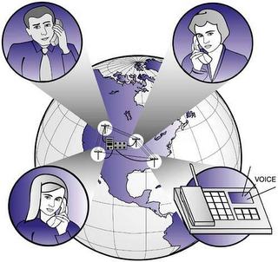
Telephony Networks
Telephony Networks
Call Origination Networks
Telephony in Contact Center

Slide 7

Telephony in Contact Center
The telephone still remains the dominant channel through which customers reach the contact center.
Telephone calls made to the contact center mostly originate from the following networks:
PSTN (Public Switched Telephone Networks)
PLMN (Public Land Mobile Network)
NGN (Next Generation Network)
IMS (IP Multimedia Subsystem)
These networks can be broadly classified to belong to either TDM technology or IP (Internet Protocol) technology.

Slide 8











Call Origination Networks
Phone
Mobile
Contact Center Platform
NGN
Mobile
Laptop/PC
IP Phone
IP Phone
Phone

Slide 9
Telephony Networks
Public Switched Telephone Network is a network of world's public telephone network, commonly known as PSTN.
Public Land Mobile Network provides land mobile telecommunication services to the public.
A Next Generation Network is a packet-based network for providing Telecommunication Services based on Internet Protocol and MPLS, also known as NGN.
The IP Multimedia Subsystem is an architectural framework for delivering Internet Protocol based multimedia services.
Notes:
PSTN:
It is Circuit Switched & also referred as Plain Old Telephone Service (POTS)
It consists of telephone lines, Fiber optic cables, undersea cables, microwave & communicate satellites.
Initially started with Fixed line analog telephone system, is now mostly digital and consists of cellular network as well.
International Telecommunication Union (ITU) creates recommendations for the telephony networks (like codecs, E.164, etc..)
PLMN:
Access to PLMN services is achieved by means of an air interface involving radio communications between mobile phones or other wireless enabled equipments.
Most often, Public Land Mobile Networks connects to the Public Switched Telephone Network (PSTN) in order to route calls.
With respect to their functions, the PLMN’s may be regarded as independent communications entities, even though different PLMN’s may be interconnected through the PSTN for the forwarding of calls or network information.
NGN:
Based on Internet technologies including Internet Protocol (IP) and multiprotocol label switching (MPLS).
Application Layer protocols: SIP and H.323
Defined separation between the transport (connectivity) portion of the network and the services that run on top of that transport.
Applications such as VoIP telephony, Video Calling, IPTV etc…
IMS:
Developed initially for streaming multimedia services for cellular devices, through GPRS.
Later developed to support other technologies like WLAN, CDMA & Fixed Line.
The user can connect to an IMS network in various ways, most of which use the Internet Protocol (IP). IMS terminals (such as mobile phones, PDA’s and computers) can register directly on an IMS network
POTS, H.323, and non IMS compatible systems are supported through Gateways

Slide 10
Traditional Telephony
Transmission Modes
Analog/Digital
Time Division Multiplexing (TDM)
TDM Interfaces – E1/T1
Integrated Services Digital Network (ISDN)
Signaling
Channel Associated Signaling (CAS)
Common Channel Signaling (CCS)
Signaling System No. 7 (SS7)

Slide 11
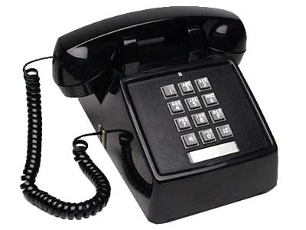

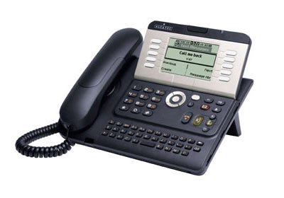
Traditional Transmission Modes
In Traditional telephony, there are two types of transmission modes -Analog transmission and Digital transmission
Analog transmission
Transmission method of conveying voice, data, image, signal or video information
Transfer of single call over a single medium
Eg: FXO/FXS
Digital transmission
Transmission method of conveying voice, data, image, signal or video information
Transfer of many calls over same medium
Eg: E1/T1, ISDN
Analog transmission has increasingly given way to Digital Transmission
Page 10
Notes:
10

Slide 12
Time Division Multiplexing (TDM)
In traditional telephony, TDM (Time Division Multiplexing), a digital transmission mode is predominantly used to transmit calls in circuit switched networks.
Phone
Mobile
TDM Network
(Digital)
E1/T1
Contact Center Platform
E1/T1
PSTN and PLMN are based on TDM technology.
Notes:
Signals are transferred simultaneously as sub-channels in one communication channel.
The time domain is divided into several recurrent timeslots of fixed length, one for each sub-channel.
In circuit switched networks such as the PSTN, TDM is used to transmit multiple subscribers’ calls along the same transmission medium.
In European systems, a TDM frame contains 30 digital voice channels, and in American systems, they contain 24 digital voice channels.

Slide 13
TDM Interfaces
E1 - European digital transmission format.
Transmitted as 32 timeslots
Data rate of 2 Mbps
Used widely in almost all countries outside the USA, Canada, Japan & Korea
T1 - American digital transmission format.
Transmitted as 24 timeslots
Data rate of 1.5 Mbps
Used in USA, Japan, Canada, Korea
An E1 or T1 has links, lines and trunks associated to them.
Notes:
E1/T1 Link: An unidirectional channel residing in one timeslot of a E1 or T1 Line
E1/T1 Line: An unidirectional E1 or T1 physical connection.
E1/T1 Trunk: A bidirectional E1 or T1 physical connection.

Slide 14
Integrated Services Digital network (ISDN)
Integrated Services Digital Network is a set of communications standards for simultaneous digital transmission of voice, video, data over the traditional circuits of the PSTN.
ISDN offers the following two services:
ISDN Basic Rate Interface (BRI)
ISDN Primary Rate Interface (PRI)
ISDN-PRI is popular throughout the world, especially for connecting PBX’s to PSTN.
Notes:
BRI: Offers two B channels and one D channel (2B+D) yielding a total bit rate of 144 Kbps.
PRI: Offers 23 B channels and one D channel in North America and Japan and 30 B channels plus one 64-Kbps D channel in other parts of the world.

Slide 15
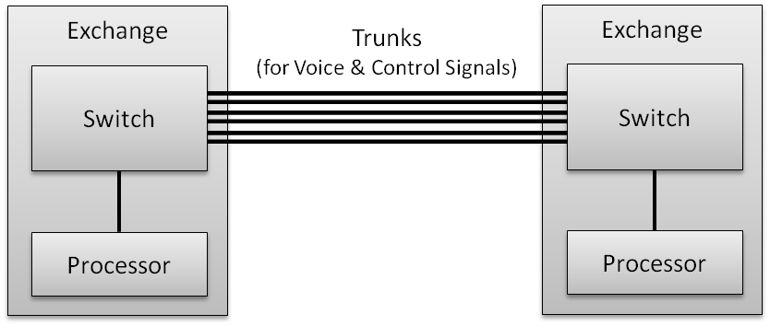
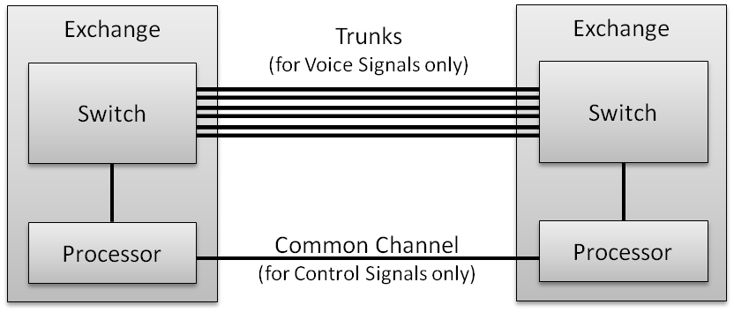
Signaling
Channel Associated Signaling (CAS) is used for in-band Signaling, e.g. MFC/R2.
Common Channel Signaling (CCS) is used for out of Band signaling, e.g. SS7.
Notes:
Signaling on circuit-switched networks can take place “in-band,” that is, on the same channel with voice communications (known as the “talk path”), or “out-of-band” (that is, through some communications channel other than the talk path).
Channel Associated Signaling (CAS)
Signaling is transmitted in the same frequency band as used by voice.
Voice path is established when the call setup is complete, using the same path that the call setup signals used.
Example: MFC/R2
Common Channel Signaling (CCS)
Employs separate, dedicated path for signaling
Voice trunks are used only when a connection is established, not before.
Faster Call Setup.
Example: SS7

Slide 16
Signaling System No. 7 (SS7)
This is a set of telephony signaling protocols which are used to set up most of the world's public switched telephone network telephone calls.
Used mainly to set-up and teardown calls
Other services include number translation, prepaid billing mechanisms, SMS
Defined by ITU-T, however, many national variants exist
Mostly used for signaling between telephone switches
Common SS7 Protocols
Telephone User Part (TUP)
ISDN User Part (ISUP).
Notes:
The Telephone User Part (TUP) defines the SS7 telephone signaling messages and functions for telephone calls.
The ISDN User Part (ISUP) defines the SS7 signaling functions and messages for supporting ISDN applications. ISUP provides a variety of services such as control of circuit-switched connections between subscribers, calling line identification, malicious call identification, call waiting, call redirection, as well as others.

Slide 17
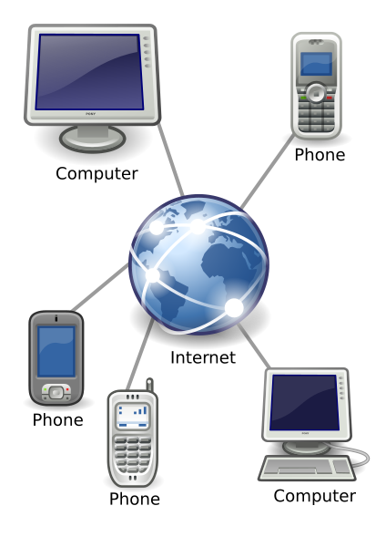
IP Telephony
Voice Over Internet Protocol (VOIP)
Session Initiation Protocol (SIP)
SIP Elements & Entities
SIP Messages
SIP Signaling
Real-time Transport Protocol (RTP)

Slide 18

Voice Over Internet Protocol (VOIP)
This is a suite of technologies used for delivery of voice and multimedia sessions over Internet Protocol (IP) networks. Common VoIP protocols include SIP & RTP.
Contact Center Platform
SIP
IP Agents
SIP
VoIP Network
SIP
NGN
Mobile
Laptop/PC
IP Phone
IP Phone
Phone
NGN and IMS are based on IP Technology
Notes:
VoIP is an application of Internet technology – Voice over IP (VoIP): Transmission of voice over Internet
How VoIP works
Continuously sample audio
Convert each sample to digital form
Send digitized stream across Internet/Intranet in packets
Convert the stream back to analog for playback
Why VoIP
IP telephony is economic; High costs for traditional telephone switching equipments.
IP Telephony Standards:
ITU (International Telecommunication Union) controls telephony standards.
IETF (Internet Engineering Task Force) controls TCP/IP standards.
Audio
Audio is encoded using a well-known standard such as Pulse Code Modulation (PCM).
Audio is transferred using the Real-time Transport Protocol (RTP)
Two major protocols: SIP, H.323

Slide 19


Session Initiation Protocol
SIP is a signaling protocol defined by Internet Engineering Task Force (IETF) used widely for controlling communication sessions such as voice and video calls over Internet Protocol (IP).
Call Setup:
SIP
Call Transport:
RTP
Services
IP Network
Endpoints
PSTN Gateway
IP Phone
Soft Phone
Phone
Notes:
SIP is an Application-layer control (signaling) protocol for creating, modifying and terminating sessions with one or more participants.
It is independent of the underlying transport layer (TCP, UDP etc..)
Can be used for creating, modifying and terminating two-party or multi-party sessions, consisting of several media streams.
It is a Text based protocol similar to HTTP : uses client-server model
Other feasible applications include Presence, IM, Video conferencing, etc.
Connection to the PSTN can be established through the use of SIP Gateways.
SIP uses DNS to Find Addresses
ENUM Maps Telephone Numbers into DNS
SIP Endpoints are Intelligent

Slide 20

SIP Elements & Entities
User Agent Client (UAC)
User Agent Server (UAS)
SIP Terminal
SIP Elements
SIP Proxy Server
SIP Gateway
SIP Redirect Server
SIP Registrar Server
Location Server
Notes:
User Agent Client (UAC) Application that initiates and sends SIP requests
User Agent Server (UAS) Receives and responds to clients requests; accepts, rejects or redirects the requests.
SIP Terminal Supports real-time, two-way communication with another SIP entity. Supports both signaling and media.
SIP Proxy Server Contacts multiple clients or servers and passes on the requests.
SIP Redirect Server Accepts SIP requests; maps the address to multiple new addresses and returns them to the client.
SIP Registrar Server Accepts REGISTER requests from clients, maintains users’ whereabouts at a location server
Location Server Provides information about a caller’s possible location to Redirect or Proxy server.
SIP Gateway Provides inter-working with PSTN and H.323

Slide 21
SIP Messages
Two Types of Messages
Requests
Responses
SIP Request Methods
REGISTER
INVITE.
ACK
CANCEL
BYE
OPTIONS
SIP Response Methods
Provisional (1xx)
Success (2xx)
Redirection (3xx)
Client Error (4xx)
Server Error (5xx)
Global Failure (6xx)
Notes:
The first line of a request has a method, defining the nature of the request, and a Request-URI, indicating where the request should be sent.
The first line of a response has a response code
SIP Request Methods
REGISTER: Used by a UA to notify its current IP address and the URLs for which it would like to receive calls.
INVITE: Used to establish a media session between user agents.
ACK: Confirms reliable message exchanges.
CANCEL: Terminates a pending request.
BYE: Terminates a session between two users in a conference.
OPTIONS: Requests information about the capabilities of a caller, without setting up a call.
SIP Response Methods
Provisional (1xx): Request received and being processed.
Success (2xx): The action was successfully received, understood, and accepted.
Redirection (3xx): Further action needs to be taken (typically by sender) to complete the request.
Client Error (4xx): The request contains bad syntax or cannot be fulfilled at the server.
Server Error (5xx): The server failed to fulfill an apparently valid request.
Global Failure (6xx): The request cannot be fulfilled at any server.

Slide 22
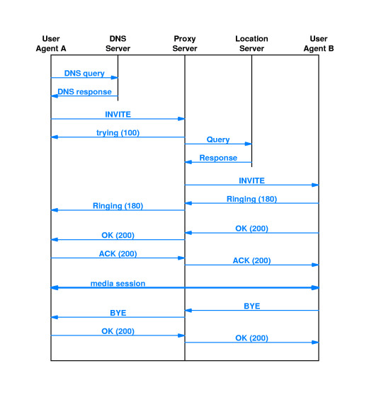
SIP Signaling
Notes:
User agent A contacts DNS server to map domain name in SIP request to IP address.
User agent A sends a INVITE message to proxy server that uses location server to find the location of user agent B.
Call is established between A and B. Then media session begins.
Finally, B terminates the call by sending a BYE request

Slide 23
Real-time Transport Protocol
This protocol defines a standardized packet format for delivering audio and video over IP networks.
Provides end-to-end delivery services for real-time traffic
Payload identification, sequence numbering, time stamping and delivery monitoring
Primarily designed to support multiparty multimedia conferences, typically assumes IP multicast.
RTP works in conjunction with RTCP (RTP Control Protocol).
RTP: carry real-time data
RTP control protocol (RTCP): monitor the quality of service and to convey information about the participants.
Can carry media streams controlled by H.323 or SIP.

Slide 24
Thank You
www.huawei.com

